Slide 1
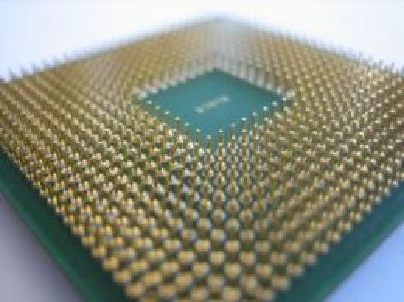
Multi-core Processing
By Group 1

Slide 2
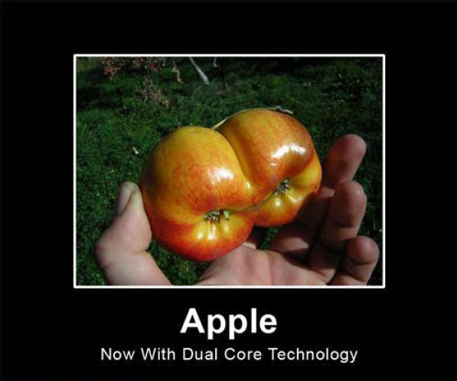

Slide 3

Main Architecture
Processors had developed from running with a low clock rate and no caches to a higher clock rate and use of caches o → multi-core processors that handed multiple threads in parallel
Three ways of handling threads o Coarse-grained and fine-grained: both time-sliced o Multithreading: simultaneous multithreading
The cores needs a way to communicate o Shared memory model o Distributed memory model
Cores can be either
homogeneous or heterogeneous

Slide 4

Same Physical space but more transistors due to advance technology
Operating Systems can now handle up to 8 core processors
Operating Systems now support hyper threading
Hyper threading
o when two threads run on one core
o to the computer looks like 2 separate cores

Slide 5

OS handles the multi core processor by managing the processes and the amount of time they have on the CPU.
Processes have enough time on the cores and every CPU execution cycle is being used for real work.
Priorities processes
It uses a variety of different methods
o round robin
o first in first out
makes sure that the system is running seamlessly, to create the illusion of multiple things happening at the same time.
It keeps track of processes
o state of any flags and switches
o any files that the process has opened
o the memory location of the process
o any hardware I/O devices the process is using

Slide 6
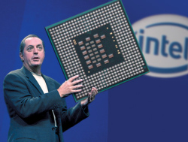
Scalability
Moore’s law o Double transistors every second year o Limit point reached soon
Amdahl’s law o Duplicating systems will run the same way as the original o Limit for the increasing speed
Scalability o Software o Communication between cores o Power

Slide 7
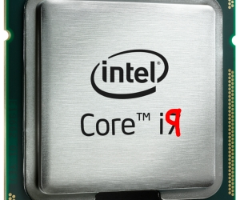
Future of Multi-Core Processing
more power
heterogeneous computing
increase efficiency of current processing
quantum computing

Slide 8

Any Questions

